Slide 1
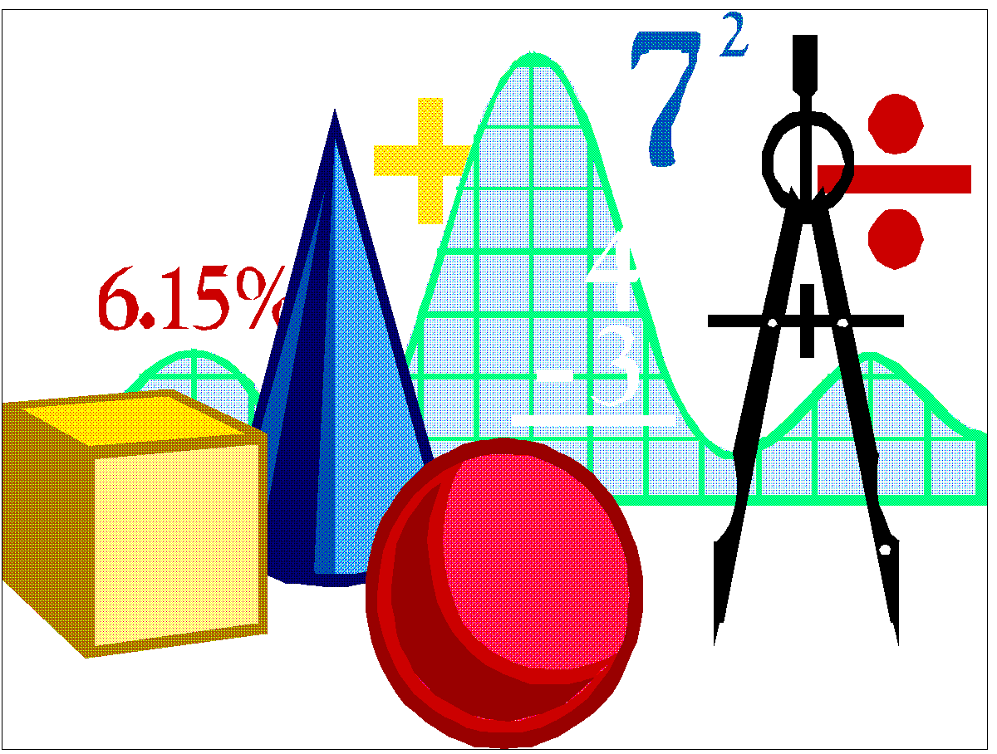
http://www.musopen.org/sheetmusic.php?type=sheet&id=2456
Integration
By: Chris Tuggle and Ashley Spivey
Period: 1

Slide 2
History of integration
-Archimedes is the founder of surface areas and volumes of solids such as the sphere and the cone. His integration method was very modern since he did not have algebra, or the decimal representation of numbers
-Gauss was the first to make graphs of integrals, and with others continued to apply integrals in the mathematical and physical sciences.
-Leibniz and Newton discovered calculus and found that differentiation and integration undo each other

Slide 3
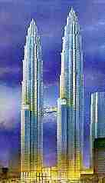

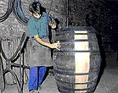
How integration applies to the real world
-Integration was used to design the Petronas Towers making it stronger
-Many differential equations were used in the designing of the Sydney Opera House
  -Finding the volume of wine casks
was one of the first uses of integration
-Finding areas under curved surfaces,
Centres of mass, displacement and
Velocity, and fluid flow are other uses of integration

Slide 4

Integration- the process of evaluating an indefinite integral or a definite integral
The indefinite integral f(x)dx is defined as a function g such that its derivative Dx[g(x)]=f(x)

Slide 5
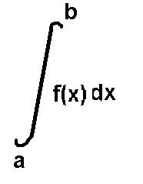
The definite integral is a number whose value depends on the function f and the numbers a and b, and it is defined as the limit of a riemann sum
Indefinite integral involves an arbitrary constant; for instance,
x² dx= x³ + c
The arbitrary constant c is called a constant of integration

Slide 6
Why we include C
-The derivative of a constant is 0. However, when you integrate, you should consider that there is a possible constant involved, but we don’t know what it is for a particular problem. Therefore, you can just use C to represent the value.
-To solve for C, you will be given a problem that gives you the y(0) value. Then you can plug the 0 in for x and the y(0) value for y.

Slide 7

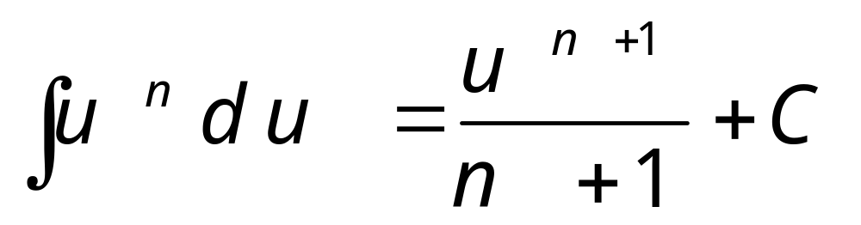
Power Rule
C = Constant of integration
u = Function
n = Power
du = Derivative

Slide 8
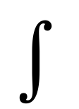
Integration by parts
-Is a rule that transforms the integral of products of functions into other functions
-If the functions are not related then use integration by parts
The equation is u dv= uv- u du

Slide 9
Example 1
(integration by parts)
x cosx dx= u=x dv=cosx dx
du=dx v= -sinx
Then you plug in your variables to the formula:
u dv= uv- u du
Which gives you:
Xsinx + sinx dx=
X sinx + cosx + c

Slide 10

Example 2
(integration by parts)
2
1 x(e^3x) dx= u= x dv= e^{3x} dx
du= dx v= 1/3 e^{3x}
Plugged into the formula gives you:
1/3x e^{3x} – 1/3 e^{3x} dx=
2
[1/3x e^{3x} – 1/9 e^{3x}]1 = [(2/3e⁶-1/9 e⁶) – (1/3e^{3x}-1/9e^{3x})]=
5/9e⁶ – 2/9e^{3x}

Slide 11
Example 3
(natural log)
Formula: (1/x)dx= lnIxI + C
lnx dx= u= lnx dv= dx
du= (1/x) dx v= x
Plugged into the formula gives you:
x lnx - dx=
Final answer: x lnIxI – x + c

Slide 12
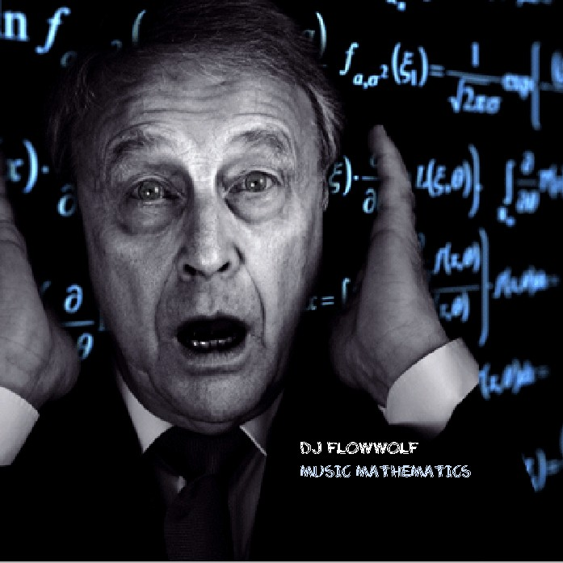
U substitution
- This is used when there are two algebraic functions and one of them is not the derivative of the other

Slide 13


Example 1
(u substitution)
x dx u=
x=(u² - 1)/(2)
udu= dx
= (u²-1/2)(u)(udu)
= ½[(u⁵/5)-(u³/3)] + C
=1/10(2x+1)^{5/2} - 1/6(2x+1)^{3/2} + C

Slide 14

Example 2
(u substitution)
x/ dx u=
x= u² + 3
dx= 2udu
(u² +3/u) x (2udu)
= 2 (u² + 3) du
=2/3u³ + 6u + C
=(2/3)(x-3)^{3/2} + 6(x-3)^{1/2} + C

Slide 15






Trigonometric substitution formulas

Slide 16
Example 1
(trigonometric substitution)
^{x(sec^2)dx} u= x dv= (sec^2)xdx
du= dx v= tanx
=xtanx- tanxdx
=xtanx + lnIcosxI + C

Slide 17

Example 2
(trigonometric substitution)
sin / dx
U=
Du= dx
N= -1/2
Solution: -2cos + C

Slide 18

Example 3
(trigonometric substitution)
cosx/ dx u= 1 + sinx
du= cosxdx
n= -1/2
sin³xcos⁴xdx=
sin²xsinxcos⁴xdx=
(1 - cos²x)sinxcos⁴xdx=
sinxcos⁴xdx - sinxcos⁶xdx=
Final solution: -1/5cos⁵x + 1/7cos⁷x + C

Slide 19


Integrating powers of sine and cosine
Integrating odd powers
Integrating even powers
Integrating odd and even powers

Slide 20
Integrating odd powers
sin⁵xdx
sin³xsin²xdx
1-cos²xsin³xdx
1-cos²xsinxsin²xdx
(1-cos²x)² sinxdx
(1-2cos^{2x} + cos⁴ x) sinxdx
sinxdx- 2cos² xsinxdx + cos⁴ xsinxdx
Final solution: -cosx – 2/3cos³ x – 1/5cos⁵ x + C

Slide 21
Integrating even powers
sin⁴ 1/2xcos² 1/2xdx=
(1-cosx/2)² (1/cosx/2)dx=
(1-cosx)(1-cos² x)dx=
(1-cos² x – cosx + cos³ x)dx=
1/8 dx – 1/8 (1 + cos2x/2)dx - 1/8 cosxdx+ 1/8 cos² xcosxdx=
1/8 dx – 1/16 dx – 1/16 cos2xdx – 1/8 cosxdx + 1/8 cosxdx – 1/8 sin² cosxdx=
1/6 dx – 1/16 cos2xdx – 1/8 sin² xcosxdx
Final solution: 1/16x – 1/32sin2x – 1/24sin³ x + C

Slide 22
Integrating odd and even powers
sin³ 6xcos² 6xdx=
sin6xsin² 6xcos² 6xdx=
sin6x(1- cos²6x)cos² 6xdx=
-1/6 sin6xcos² 6xdx - sin6xcos⁴ 6xdx=
u= cos6x
du= -6sin6x
n= 2
Final solution: -1/18cos³ 6x + 1/30cos⁵ x + C

Slide 23
Integration by partial fractions
Used when:
-Expressions must be polynomials
-Power rule should be used at some point
-The denominator is factorable
-Power or exponent represents how many variables or fractions there are

Slide 24
Example 1
(partial fractions)
(6x² - 2x – 1)/(4x³ – x) dx
(A/x) + (B/2x - 1) + (C/(2x+1)
A(4x² -1)----→4Ax² - A
Bx(2x + 1)--→2Bx² + Bx
C(2x-1)------→2Cx² – Cx
2A + B + C= 3
B – C= -2 (1/x)dx + -1/2 (dx/2x-1) + 3/2 (dx/2x+1)
A=1 Final solution: lnIxI – 1/4lnI2x-1I + 3/4lnI2x+1I + C
B + C=1
+B – C= -2
B= -1/2 C= 3/2

Slide 25
Example 2
(partial fractions)
(x+1)/(x² – 1)dx A(X+1) B(X-1)
A/(x-1) + B/(x+1) AX+A BX-B
A + B= 0
+ A – B= 1
2A=1
A=1/2
B=-1/2 1/2 (1/x-1)dx- ½ (1/x+1)dx
Final solution: 1/2lnIx-1I – 1/2lnIx+1I + C

Slide 26
Example 3
(partial fractions)
(3x² - x + 1)/ (x³ - x²)dx
Ax(x-1)---→ Ax² - Ax
B(x-1)-----→Bx - B
Cx² --------→Cx²
A + C=3
+-A + B=-1
B=-1
-1/x² dx + 3/x-1 dx
Final Solution: 1/x + 3lnIx-1I + C

Slide 27
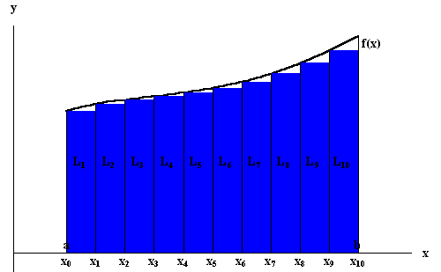

Definite integration
-This is used when the numerical bounds of the object are known

Slide 28

Example 1
(definite integration)
/2
0 x cosx dx= u= x dv= cosx dx
du= dx v= sinx
Plugged into the formula gives you:
/2 x sinx - sinx dx= [(x sinx) + (cosx)] 0 =
( /2 + 0) – (0 + 1) =
Final Answer:
( /2) - 1

Slide 29

Example 2
(definite integration)
4
x dx u=
0
x= -u² + 4
dx= -2udu
(-u² + 4)u(-2udu)
(2u⁴ - 8u²)du 4
-8/3u³ + 2/5u⁵ = [-8/3(4-x)^{3/2} + 2/5(4-x)^{5/2}]0
Final solution: (-64/3 + 64/5) – (0)= -320 + 192/15 = -128/5

Slide 30
Bibliography
http://integrals.wolfram.com/about/history/
http://www.sosmath.com/calculus/integration/byparts/byparts.html
http://myhandbook.info/form_integ.html
http://www.math.brown.edu/help/usubstitution.html
http://www.math.ucdavis.edu/~kouba/CalcTwoDIRECTORY/partialfracdirectory/PartialFrac.html
http://demonstrations.wolfram.com/IntegratingOddPowersOfSineAndCosineBySubstitution/

